Slide 1
Introduction to Python
Instructor: Hisham Madkour

Slide 2
What is Python?
Python is a clear and powerful object-oriented programming language, comparable to Perl, Ruby, or Java.
An object is something that can hold data and ca have actions associated with them
Python can be used to create GUI applications, data science, game development, optimize business processes and more.
The concepts and syntax learned in Python are transferrable to other programming languages

Slide 3
Resources
eBook 1 and eBook 2
Hard Copy book
Visualizing Code tool
Cheat Sheets
*Control click to go to the link.

Slide 4
How do I Open Python?
Install Python for your OS on www.python.org and download the most current version
Search “Python IDLE” in your Start Menu
You can also practice coding on https://repl.it/ or http://pythontutor.com/ No installation required!
Notes:
Import antigravity
Import this

Slide 5
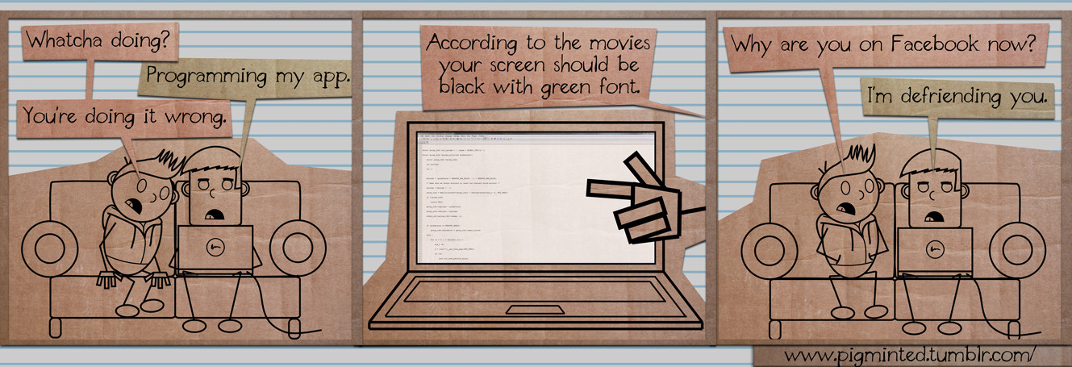
Get familiar with your IDE
You can use the default IDE (recommended) or other IDE’s such as Visual Studio, Spyder, Pycharm, or any of the dozens available
You can also use https://repl.it/ or http://pythontutor.com/ if you cannot or do want to install

Slide 6
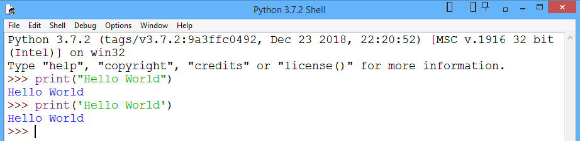
Your first line of code
The “Hello World” program is a rite of passage for all new programmers.
Use the print function to display the message Hello World on the screen
Run this line interactive shell
Hello World outputted in Immediate Mode
We will run scripts in a future exercise

Slide 7
BASIC Data Types
Numbers: integers, floats, complex numbers
Text: strings, special characters, Unicode characters
Boolean: True or False
None: Value does not exist
Sequence: lists, tuples, rangers
Binary: Byte, bytearray
Notes:
We will cover the remaining in future classes

Slide 8
Color Test
Type the following into your IDE. Note the color changes
False | not | finally | return
None | continue | for | try
True | def | from | while
and | del | global | with
as | elif | if | "hello"
is | else | import | 123
break | import | in | “123"

Slide 9
Storing variables
Variables are buckets that store data which you can read or update later
Variables store data like strings, numbers, Booleans, and more
name = “Monty” weight = 150
active = False
You can store multiple variables at a time
a = 1
a, b, c = 1, 3, 5
a = b = c = 3

Slide 10
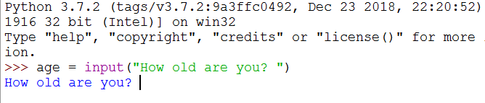
Input
You will often need the user to define a variable for you.
Use an input statement to store data from the user.
Important: Input is stored as a string by default

Slide 11
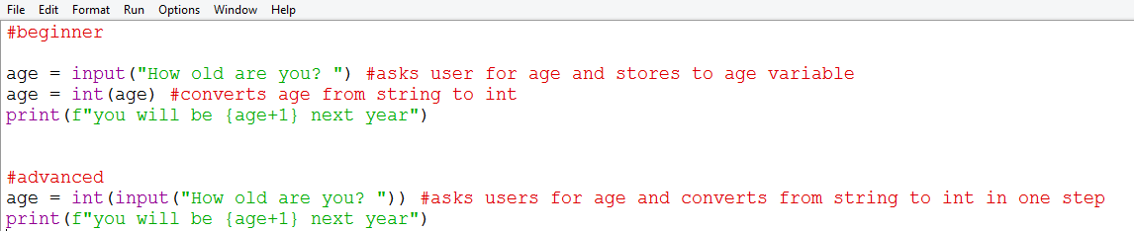
Input and converting data types
Input is stored as a string by default.
You can convert data types using the int() or float() function
Below shows how to store input as variable and convert data types

Slide 12
Reassigning and Deleting variable
Variables can be re-assigned to other values and other data types.
x is going to be assigned as the integer 1, then re-assigned to the integer 3, then re-assigned to the string “car”
x = 1
x = 3
x = “car”
To delete a variable use:
del x

Slide 13
In Place Operators
In place operators allow you to complete operations and assign them to a variable more concisely. The method below works with addition, subtraction, division, and multiplication
You can re-assign and concatenate strings in a new variable with +=
x = “sun” y = “flower” x += y will re-assign the variable x to “sunflower” Note: the value of y does not change
Standard Method |  | In Place Operator Method
x = 3 |  | x = 3
x = x+ 4 |  | x += 4
Notes:
Many languages use ++ as in place operators but Python does not

Slide 14
What do I Name my Variable?
Rules
Best Practices (per pep8)
Variables must start with a letter or underscore. Cannot start with numbers or special characters
Rest of the name can contain letters, numbers and underscores but no special characters
Variable names are case sensitive
Variables must be declared before they are used
Variable name must be on the left and value it is being assigned on the right of the equal sign
Cannot be named reserved words such as print or int
Keep short but descriptive
Variables should be in snake_case instead of camelCase
Keep variables lower case
__variable__ for variables that should not be modified

Slide 15
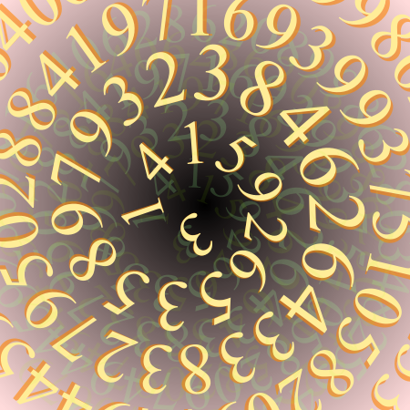
Numbers!

Slide 16
Types of numbers
Data Type | Definition | Examples
Integer | Whole number | 4, 400, -30
Floating Point (aka floats) | Decimal Point | 0.0, 1.4, 3.2
There are 2 additional numerical data types (long and complex) which are not covered in this course.
They are mostly used in cases that require unusually high levels of accuracy or are dealing with imaginary numbers

Slide 17
Basic Operators
Operator | Name | Syntax | Output
+ | Addition | 10+1 | 11
- | Subtraction | 10-1 | 9
* | Multiplication | 10*1 | 10
/ | Division | 10/5 | 2.0

Slide 18
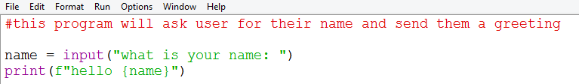
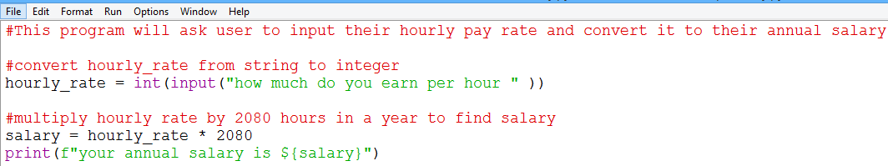
Practice

Slide 19
Pemdas
Python follows order of operations (PEMDAS)
Python is dynamically typed meaning you can convert data types
Operations between floats and integers will always return an integer 4+2.0 = 6.0

Slide 20
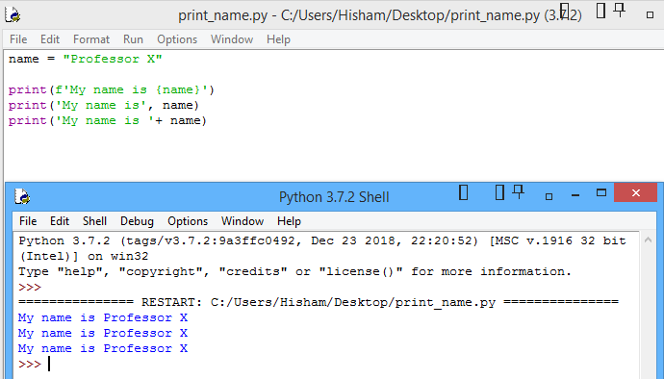
Strings!
A string is a way to communicate literal phrases
You can choose to wrap strings in single quotes or double quotes.
There are multiple ways to print a variable inside a string statement
Code
Output

Slide 21
String Escape Sequences
The following is a list of escape sequences. The characters “escaped” from being printed as a literal strings and completed something else
Sequence | What it does | Syntax | Output
\n | Creates new line | print(“Hello\nWorld”) | Hello World
\t | Inserts a tab | print(“Hello\tWorld”) | Hello World
\’ or \” | Inserts quotes within string | print(“I said \“Hello””) | I said “Hello”
\u | Prints Unicode characters | print(u"\u00a9") | ©
\\ | Adds a back slash | print("File is saved in C:\\Norway\History") | File is saved in C:\\Norway\History

Slide 22
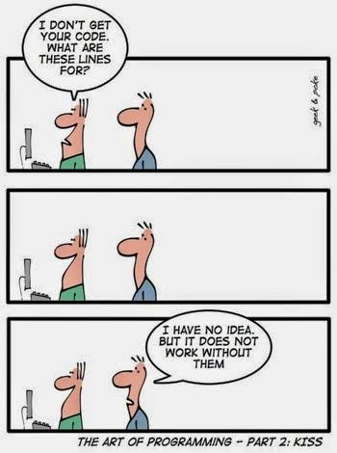
Commenting
Comments can be used with # or multiline using quotation marks “” ””
Anything written as a comment will be ignored by the Python Interpreter
Two purposes for comments
1. Communicating the purpose of your code to yourself, your coworkers, and others
2. Can be used while debugging purposes instead of deleting your code (commenting out)

Slide 23
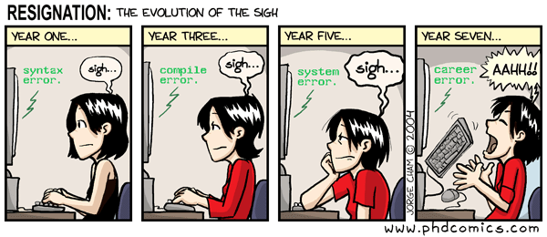
Errors

Slide 24
Understanding Error Messages
Error Type | Possible Reasons This Error Appears
SyntaxError | Grammatical mistakes such as did not close parenthesis, quotation marks, or misspellings,
NameError | You are referencing a variable name that does not exist. Remember variables are case sensitive
TypeError | Your data types (string, int, etc) are incompatible
IndentationError | Python is space sensitive. Code needs to indented or an indent needs to be deleted
ZeroDivisionError | Zero is in the denominator of a division statement

Slide 25
Review questions
How do I open the Python Interpreter?
What happens when you add a string and float?
What happens when you add an integer and a float?
What is a Syntax Error?
What is the order of operations
What does this code output? print(4+3*2)
What does this code output? print(“Please \n Slow \n Down”)

